Slide 1
Integrated and Decoupled Models for the Production Routing Problem with Backlogging
Journées STP du GdR MACS à Grenoble, 19 et 20 mai 2016
Présentation pour le GT BERMUDES
N. BRAHIMI, Ecole des Mines de Nantes / IRCCyN
T. Aouam, University of Ghent, Belgium
Presented by: Nadjib BRAHIMI, PhD
Equipe: Systèmes Logistiques et de Production
Département d’automatique, Productique et Informatique
Ecole des Mines de Nantes

Slide 2
Outline
Introduction
Literature review
Formulations for the coordinated approach
  Aggregate formulation
  Strong formulation
A formulation for the decoupled approach
Computational results
A relax-and-fix heuristic
Conclusions and Perspectives

Slide 3
Outline
Introduction
Literature review
Formulations for the coordinated approach
  Aggregate formulation
  Strong formulation
A formulation for the decoupled approach
Computational results
A relax-and-fix heuristic
Conclusions and Perspectives

Slide 4
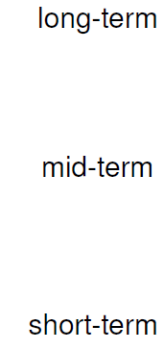
Context: A research strategy
Procurement
Production
Distribution
Sales
Inventory-Location
Dynamic lot sizing
Procurement – Prod. Planning
Production Planning with
Order Acceptance Decisions
Planning/
schedudling
Production
Distribution
Inventory/
Production-Routing
- New integrated models:
economic benefits based on MILPs and simulations
- OR models and algorithms:
Strong formulations, decomposition, Lagrangian Relaxation, MILP heuristics, (meta) heuristics, …

Slide 5
Introduction
A set of items ( N ) with dynamic demand over T periods for each customer.
Problem:
  Schedule production of items (lot sizing problem)
  Schedule delivery of customers
  Minimize:
    Production, inventory, backlogging costs, and
    Distribution costs
  Constraints: Production, delivery, storage capacities
t = 1
t = 2
t = 3

Slide 6
Introduction
Problem is NP-hard, composed of two NP-hard problems
  Capacitated lot sizing and
  Rehicle routing
Approaches:
  Decoupled: Solve lot sizing then vehicle routing
  Integrated: Both decisions taken at the same time:
    Advantages
    Efficient algorithm

Slide 7
Outline
Introduction
Literature review
Formulations for the coordinated approach
  Aggregate formulation
  Strong formulation
A formulation for the decoupled approach
Computational results
A relax-and-fix heuristic
Conclusions and Perspectives

Slide 8
Literature review
Lot sizing literature:
  Brahimi et al. (2006)
  Jans and Degraeve (2008)
  With backlogging
  Single item lot sizing: Zangwill (1966, 1969)
  Capacitated Single item lot sizing: Van-Vyve (2006)
  Capacitated multi-item problem: Millar and Yang (1994)
Vehicle routing literature:
  Toth and Vigo (2002)
  Golden et al. (2008)

Slide 9
Literature review
Production Routing Problem (PRP)
  Simplifying assumptions
    Single item: Ruokokoski et al.(2010)
    No production costs: Fumero and Vercellis (1999)
  Solution approaches:
    Branch and cut: Ruokokoski (2010)
    Tabu Search: Bard and Nananukul (2010)
    Other heuristics: Boudia and Prins (2009)
  Recent literature review: Adulyasak, Cordeau et Jans (2014)
  Senoussi, et al. (2015)

Slide 10
Outline
Introduction
Literature review
Formulations for the coordinated approach
  Aggregate formulation
  Strong formulation
A formulation for the decoupled approach
Computational results
A relax-and-fix heuristic
Conclusions and Perspectives

Slide 11
Problem formulations: Coordinated Approach
Lot sizing problem formulations:
  Simple aggregate formulation (AGG)
  Facility location-based formulation (FAL)
  Shortest-path formulation
Vehicle routing formulations
  Two index formulation with Desrochers-Laporte Subtour Elimination Constraints
  Three index formulation with Miller-Tucker-Zemlin Subtour Elimination Constraints.

Slide 12
Outline
Introduction
Literature review
Formulations for the coordinated approach
  Aggregate formulation
  Strong formulation
A formulation for the decoupled approach
Computational results
A relax-and-fix heuristic
Conclusions and Perspectives

Slide 13
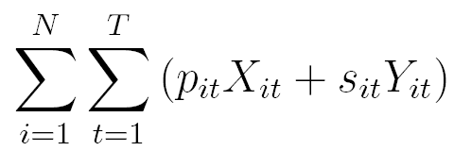
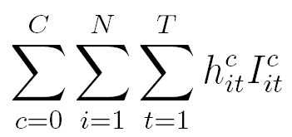
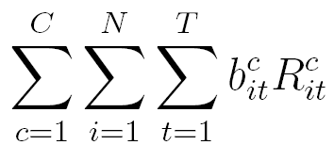
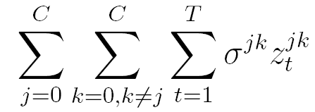
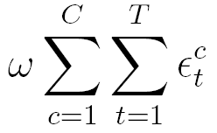
Model: AGG-DL-NLP
Minimize
Production +Setup cost +
Inventory holding cost +
Backlogging cost +
Traveling cost +
Service cost

Slide 14
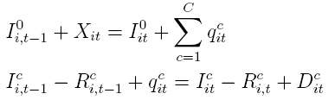
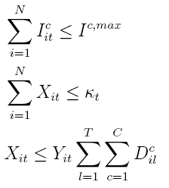
Model: AGG-DL-NLP
Constraints:
Production Planning Constraints

Slide 15



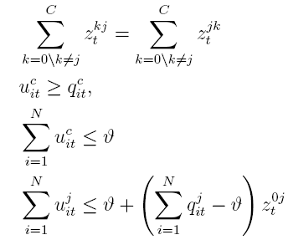

Routing Constraints
Non-linear constraints

Slide 16
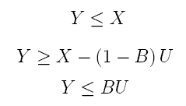

Linearizing the model
X, Y: continuous non-negative variables
B: Binary variable
⬄

Slide 17


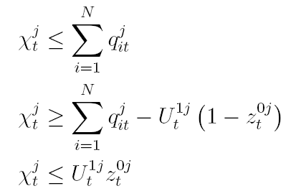
Linearizing the model
Introduce a new variable
⬄

Slide 18
Outline
Introduction
Literature review
Formulations for the coordinated approach
  Aggregate formulation
  Strong formulation
A formulation for the decoupled approach
Computational results
A relax-and-fix heuristic
Conclusions and Perspectives

Slide 19

Strong formulation: FAL-DL-NLP
Introduce new variable

Slide 20


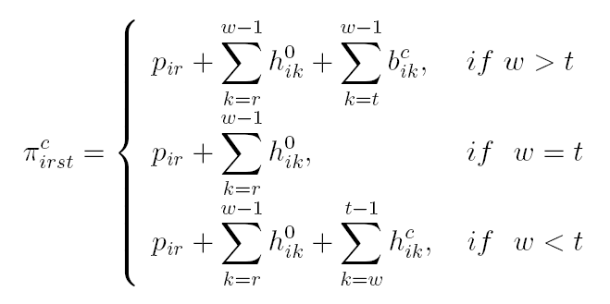


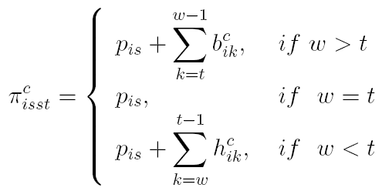
Introduce new cost:

Slide 21
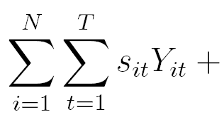
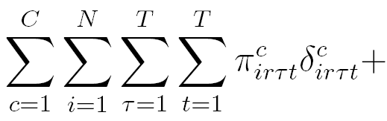
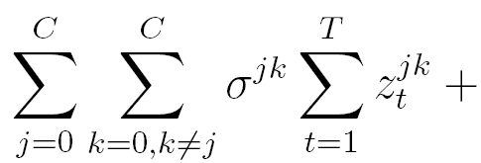
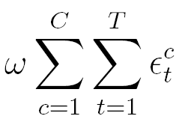
FAL-DL-NL model (non linear)
Minimize
Setup cost +
Production+Holding+Backlogging+
Traveling cost +
Service cost
Subject to modified Constraints:

Slide 22
Outline
Introduction
Literature review
Formulations for the coordinated approach
  Aggregate formulation
  Strong formulation
A formulation for the decoupled approach
Computational results
A relax-and-fix heuristic
Conclusions and Perspectives

Slide 23
A formulation for the decoupled approach
Lot sizing phase (two-level problem)
Decide about customers to visit
Vehicle routing phase
Sequencing

Slide 24
Outline
Introduction
Literature review
Formulations for the coordinated approach
  Aggregate formulation
  Strong formulation
A formulation for the decoupled approach
Computational results
A relax-and-fix heuristic
Conclusions and Perspectives

Slide 25

Computational Results
Generated data sets
Small size problems
Parameter | Values
Production Capacity Factor (PCF) | 1, 2, 6
Storage Capacity Factor for the Plant (SCFP) | 0, 1, 2, 6
Storage Capacity Factor for the Customers (SCFC) | 0, 1, 2, 3
Backlogging Cost Factor (BCF) | 5, 50, 100
Maximum coordinates (MaxXY) | 500, 1000, 2000
Unit Transportation Cost (UTC) | 1, 2, 3
Vehicle Capacity Factor (VCF) | 2, 3, 5
Large size problems
Parameter | Values
T | 6, 12, 18
N | 1, 5, 10
C | 10, 15, 20

Slide 26
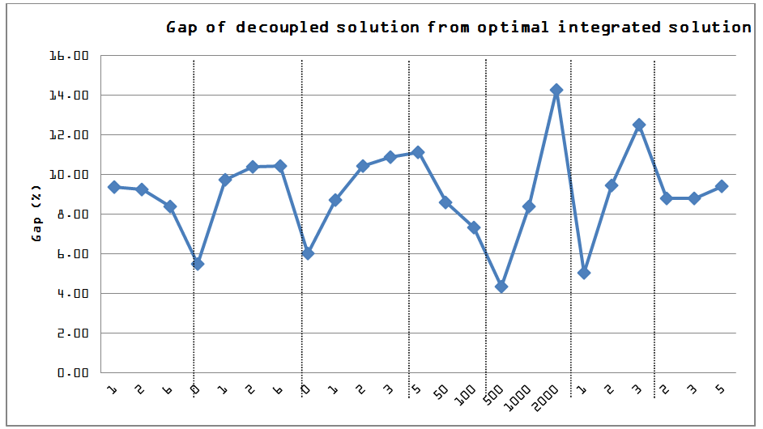
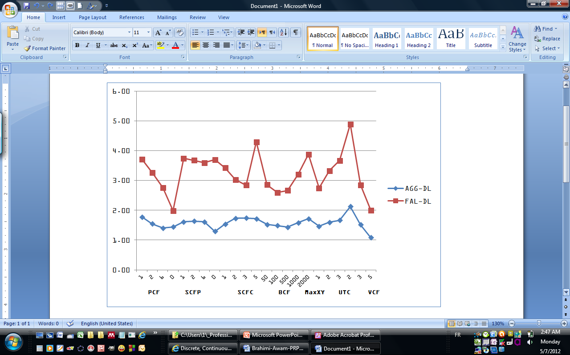

Slide 27
Outline
Introduction
Literature review
Formulations for the coordinated approach
  Aggregate formulation
  Strong formulation
A formulation for the decoupled approach
Computational results
A relax-and-fix heuristic
Conclusions and Perspectives

Slide 28
L’heuristique hybride
1. L’heuristique relax-and-fix
Periods
1
2
3
4
5
6
7
8
9
10
11
12
13
14
15
16
17
18
19
Itération 1
Intégrité
Relaxé
Periods
1
2
3
4
5
6
7
8
9
10
11
12
13
14
15
16
17
18
19
Itération 2
Fixé
Intégrité
Relaxé
Itération 3
Periods
1
2
3
4
5
6
7
8
9
10
11
12
13
14
15
16
17
18
19
Fixé
Intégrité
Relaxé
.
.
.
.
Itération n
Periods
1
2
3
4
5
6
7
8
9
10
11
12
13
14
15
16
17
18
19
Fixé

Slide 29
L’heuristique hybride
2. L’heuristique hybride
Periods
1
2
3
4
5
6
7
8
9
10
11
12
13
14
15
16
17
18
19
Fixé
Intégrité
Relaxé
Variables production
Clients à visiter
Variables de routage
A chaque itération:
Etape 1: Forcer l’intégrité sur les variables de production et
les variables pour visiter les clients
(relaxer les variables de routage)
Résoudre avec le solveur
Etape 2:
Utiliser l’algorithme de recherche locale de Groër pour résoudre le
problème des tournées (dans l’intervalle « intégrité »)
Fixer les variables pour l’itération suivante.

Slide 30
Comparaison des méthodes
HRF: Hybrid Relax and Fix, AGG30 et FAL30: Les modèles AGG et FAL exécutés pendants 30 minutes maximum

Slide 31
Outline
Introduction
Literature review
Formulations for the coordinated approach
  Aggregate formulation
  Strong formulation
A formulation for the decoupled approach
Computational results
A relax-and-fix heuristic
Conclusions and Perspectives

Slide 32
Conclusion and perspectives
Importance of testing different mathematical formulations
FAL formulation is better for large problems mainly if it is given enough execution time
The decoupled approach is the best in some special cases
Perspectives
Iterative approach for the decoupled model
Decomposition methods
Hybrid approach: Meta-heuristics with Decoupled methods

Slide 33
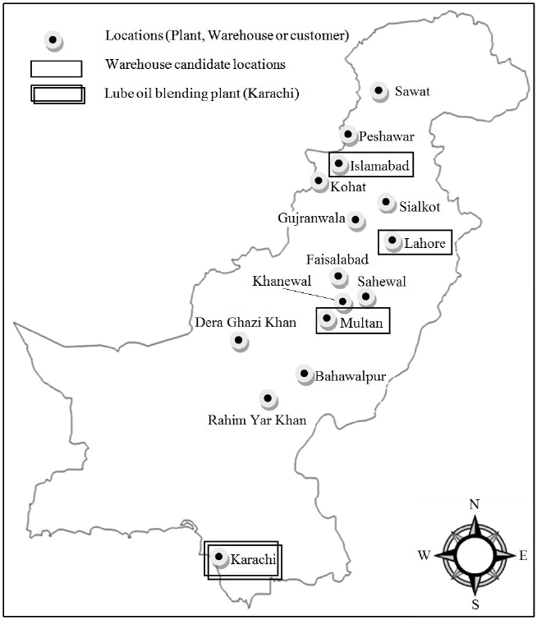
6. Travaux de recherche: Exemple 1 Production/Localisation/Distribution (Etude de cas au Pakistan)
Contexte (avec EXXON Mobile)
  Production et importation de lubrifiants industriels à Karachi
  L’entrepôt actuel est situé à Lahore
Problème:
  Les coûts d’entreposage sont trop élevés
  La qualité de service n’est pas acceptable
Proposition:
  Libérer 50% de l’entrepôt actuel
  Louer de l’espace avec Agility-3PL (On paie un coût fixe + coût variable)
Questions
  Où on doit louer l’espace?
  Comment livrer les entrepôts et les clients (inclue le type de véhicules)?

Slide 34
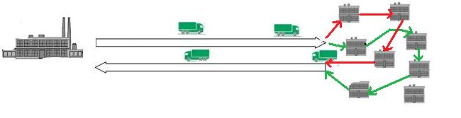
2. Production-Distribution
Avec Senoussi A., Pentz B., et Dauzère-Pérès S.
Planifier la production au niveau de l’usine
Planifier la distribution chez les clients (points de vente)
  En ne tient pas compte du séquencement des clients
  On décide seulement de ceux qu’il faut visiter
Exemple 1:
Exemple 2:
  Transport maritime
  Autoroute

Slide 35

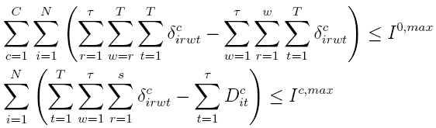
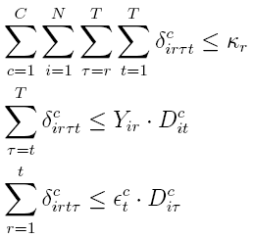
Appendix: Production Planning Constraints for the disaggregate formulation

Slide 36
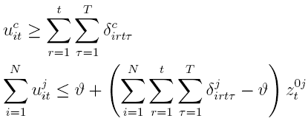


Routing Constraints

