Slide 1

An Empirical Comparison of MRP II and
Demand-Driven MRP
R. Miclo, F. Fontanili, M. Lauras, J. Lamothe, B. Milian
8th MIM Conference

Slide 2
1
Introduction
2
DDMRP description
3
Method to address the issue
4
A case study
5
Conclusion & Perspectives

Slide 3





Introduction
About the research work :
    PhD student at “École des Mines Albi-Carmaux“, France
With a company:
    AGILEA : a consulting and training firm specialized in Supply Chain Management located in Toulouse
AGILEA and Demand-Driven MRP:
    official training organism recognized by the DDI
    12 CDDP consultants with on-going DDMRP implementation projects
    Replenishment+ (DDMRP software) distributor

Slide 4

Article issue
DDMRP invented by C. Ptak and C. Smith :
    3rd edition of Orlicky’s Material Requirements Planning book
    More on more DDMRP implementations (worldwide)
    New DDMRP book is coming next month from C. Ptak and C. Smith
In which environments DDMRP is better than other flow management methods?

Slide 5
1
Introduction
2
DDMRP description
3
Method to address the issue
4
A case study
5
Conclusion & Perspectives

Slide 6


DDMRP description
Sources of variability:
All material and content © copyright 2013 Demand Driven Institute. All rights reserved

Slide 7
DDMRP description
A multi-echelon materials and inventory planning and execution solution.
Demand Driven MRP
(DDMRP)
Material Requirements Planning
(MRP)
Distribution Requirements Planning
(DRP)
Lean
Theory of Constraints
Six Sigma
Innovation
All material and content © copyright 2013 Demand Driven Institute. All rights reserved

Slide 8
DDMRP description
Demand Driven Material Requirements Planning
Strategic Inventory Positioning
Buffer Profiles and Levels
Dynamic Adjustments
Demand Driven Planning
Visible and Collaborative Execution
1
2
3
4
5
Modeling/Re-modeling the Environment
Plan
Execute
All material and content © copyright 2013 Demand Driven Institute. All rights reserved

Slide 9
DDMRP description
All material and content © copyright 2013 Demand Driven Institute. All rights reserved

Slide 10
DDMRP description
All material and content © copyright 2013 Demand Driven Institute. All rights reserved

Slide 11
DDMRP description
All material and content © copyright 2013 Demand Driven Institute. All rights reserved

Slide 12
DDMRP Planning & Execution
Planning:
  Net Flow Equation
  = On hand + Supply Orders – (Day Demand + Spike in Lead Time)
  Order quantity = Top Of Green - Available Stock Equation
Execution:
  Criticality Ratio = On Hand / Red Zone
gives a percentage to manage priorities.
Spike

Slide 13
DDMRP description
All material and content © copyright 2013 Demand Driven Institute. All rights reserved

Slide 14
DDMRP description
All material and content © copyright 2013 Demand Driven Institute. All rights reserved

Slide 15
1
Introduction
2
DDMRP description
3
Method to address the issue
4
A case study
5
Conclusion & Perspectives

Slide 16
Method to address the issue
DDMRP aims at reaching three main objectives :
    Manage the different variability sources in order to assure the best OTD level.
    Improve WIP management: having right references and the right quantities.
    Be able to adapt “easily“ to demand, that is to say managing to produce orders even with high workload levels.
Our work wants to challenge these objectives in case studies in order to define improvement levers and quantify their impacts:
    From DDMRP, MRPII and Kanban (added since the article redaction)

Slide 17
Method to address the issue
In order to compare the different methods, Discrete-Event Simulation (DES) is used for its main advantages:
    Implementing variability sources
    Having a dynamic dimension
The main scenario that must be assessed:
    External variability – demand variability (with demand spike management)
    Demand seasonality
    Higher external variability with demand spikes detection

Slide 18
Method to address the issue
Impacts will be assessed through these KPIs :
    On-Time Delivery (%)
    Working Capital (€)
Then for each scenario assessed, we will analyse the Working Capital amount needed to reach a near perfect OTD level.

Slide 19
1
Introduction
2
DDMRP description
3
Method to address the issue
4
A case study
5
Conclusion & Perspectives

Slide 20
A case study
A reducer production company is studied here (CIPE Kanban serious game).
    5 step process : With important (Setup Times : production time)
      A Crown (3h: red-white-green 200/h) -> B crown (4h)
      Oil pan machining (3h : yellow-white) Assembly (1h : 6 versions)
      Gear Machining (3h : red-blue)
    Shop is saturated => each part made 1/week : Oil pan, Gear, Assembly
In DDMRP, the strategic inventory positioning step:
    Only A crown parts are not buffered

Slide 21
Evaluation methodology
A reference situation :
    6 months warm up + 6 months assessment
Witness ® : Simulation of the planning strategy
    MRP : 1 plan per week + sequence order according stock availability
    DDMRP : 1 order when enter Yellow Zone + sequence according to DDMRP Critical Ratio
    Kanban : Produce until another enters “Red Zone“ (emergency indicator)
Witness ® : Simulation of the flows at shop floor level
Tuning each strategy in order to reach:
    99,3% On time Delivery
    Minimize Working Capital : Total inventory + Work in Process

Slide 22
A case study
Results:
  Results are quite similar for the three methods for the initial scenario.
  For this scenario, demand is nearly flat and there are only breakdowns as variability sources: that is why similar results were expected here.

Slide 23
A case study
Results:
  Results are quite similar for Kanban and DDMRP.
  However MRP needs a high WC to reach a good OTD.

Slide 24
A case study
(Spikes)
+ Spikes
98,8%
Seasonality is modeled here with an equivalent total load on the year :
    DDMRP
      Plan Adjustment Factors to adapt Average Demand each month
    Kanban : Apply PAF factor on card number
    MRP has a higher Working Capital amount

Slide 25
High external variability
Results:
The external variability presented before is deeply increased in this scenario. In this case, firmed demand is also known 5 days in advance (spikes detection for DDMRP) :
    MRP has still problems with only 86% OTD
    Kanban has here an unacceptable OTD level
    DDMRP (same tuning) has an excellent OTD but its costs in terms of Working Capital
98,8%

Slide 26
DDMRP criticize on MRP
Oscillation
# of parts or SKU
Too Little
Warning
Optimal Range
Warning
Too Much
0
All material and content © copyright 2013 Demand Driven Institute. All rights reserved

Slide 27
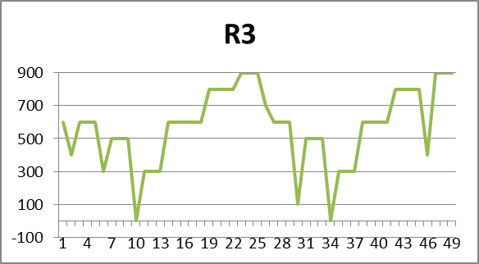
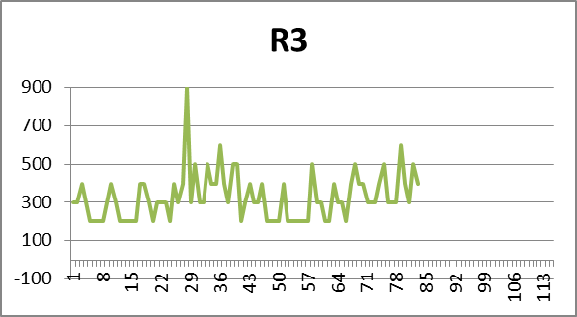
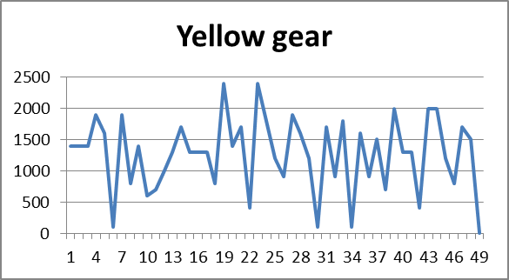
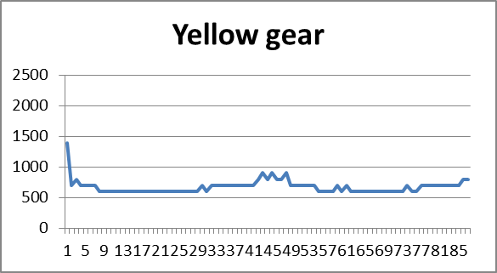
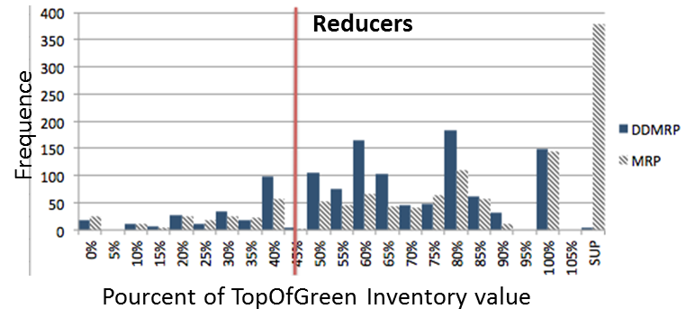
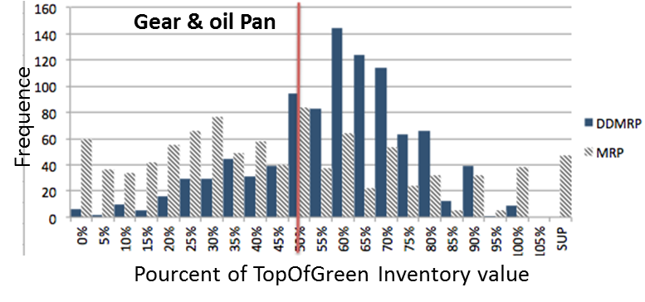
Behaviour of orders and inventories
MRP DDMRP
DDMRP :
More orders of fixed size.
Execution priorities enable to decide on grouping orders for avoiding setups.

Slide 28
1
Introduction
2
DDMRP description
3
Method to address the issue
4
A case study
5
Conclusion & Perspectives

Slide 29
Conclusion and perspectives
Conclusion:
    Presentation of our design of experiments with DDMRP compared to MRPII and Kanban
    These results confirm that when variability increases, MRPII has not good results in terms of both OTD and Working Capital
    Kanban and DDMRP has results quite close, but when there is seasonality and furthermore spikes that must be anticipated, DDMRP has better results (a big gap with spike detection).

Slide 30
Conclusion and perspectives
Perspectives:
    Test the different methods with several environments (case studies): longer BOMs
    Try to test different methods (ConWIP…)
    Try this experiment on a real case study (an on-going work)
    Optimise the DDMRP buffer dimensioning

Slide 31
Thank you for paying attention!
If you have any questions?
romain.miclo@mines-albi.fr

Slide 32
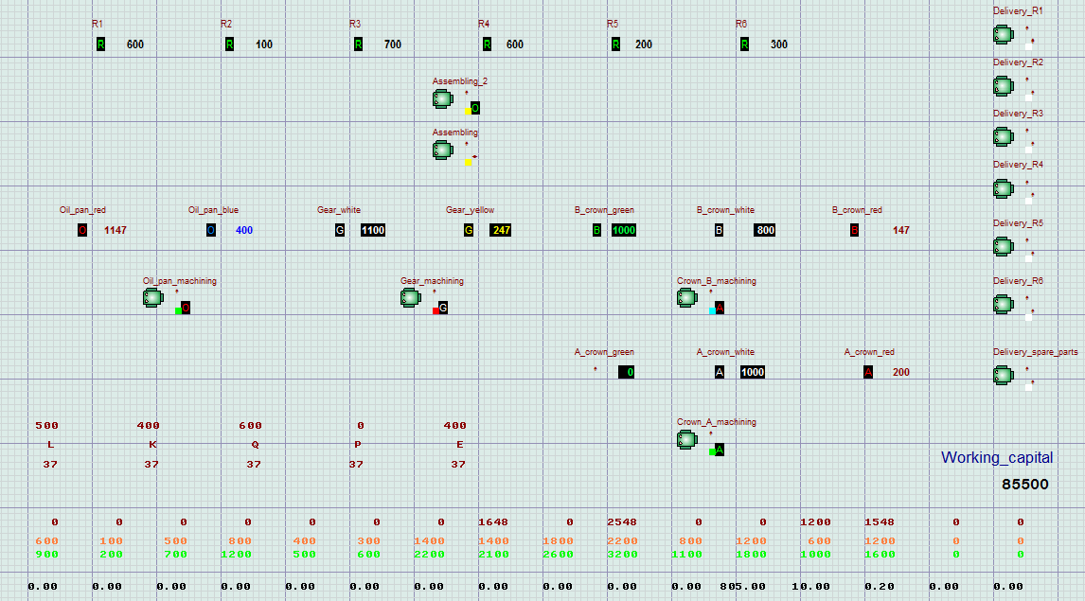
A case study
Witness® simulation model :

Slide 33
Buffer positionning

Slide 34
A case study
Results:
    Distribution laws to add internal variability: unit cycle time and setting-up time (with triangular law ±50% for the initial fixed value).
    Here the gap between MRP and DDMRP / Kanban is also obvious. Kanban and DDMRP have also similar results.

Slide 35
DDMRP description
GreenZone = Max(YellowZone. LTFactor; LotSize)
YellowZone = ADU. PAF. LeadT
RedZone = YellowZone. LTFactor. (1+VariabilityFactor)
All material and content © copyright 2013 Demand Driven Institute. All rights reserved

Slide 36
Behaviour of orders and inventories
MRP DDMRP
DDMRP :
More orders of fixed size.
Execution priorities enable to decide on grouping orders for avoiding setups.
 | MRPII |  |  |  |  | DDMRP |  |  |  |  | Real Demand
part | R | Gear | Oil Pan | B crown | A crown | R | Gear | Oil Pan | B crown | A crown
Sc1 | 35.4% | 43.9% | 33.4% | 36.6% | 35.4% | 53.4% | 37.2% | 26.8% | 52.2% | 40.2% | 45.0%
Sc2 | 34.4% | 39.8% | 29.1% | 42.2% | 43.5% | 59.2% | 42.3% | 32.6% | 58.5% | 52.3% | 45.0%

