Slide 1
Robust single machine scheduling with external-party jobs
Paolo Detti, Università di Siena, Italy
Gaia Nicosia, Università “Roma Tre”, Italy
Andrea Pacifici, Università di Roma “Tor Vergata”, Italy
Garazi Zabalo Manrique de Lara, Università di Siena, Italy

Slide 2
The addressed problem
Single machine scheduling problem.
The owner of a machining resource must process:
  its own internal jobs
  jobs belonging to an external party
Objective: minimize total completion time of its own jobs
Notes:
1. INTRODUCTION
In this paper we address a problem arising in a manu-
facturing environment in which the owner of a machining resource, besides its own internal jobs, must also process
jobs belonging to an external party, and is interested in minimizing the total completion time of its own jobs.
Due to contract commitments, the external jobs must
be processed within a certain due date, which has to
be considered as a deadline. Moreover, these jobs have a
given release date corresponding to their actual availability
in the manufacturing system. The external party's jobs
arrive with nominal duration, however such duration is
only an estimate, and therefore the owner of the machining
resource, when planning the schedule of the jobs must take
into account possible deviations from the nominal values
of the processing times. For this reason it is important
to determine a schedule which is robust to any possible
changes in the durations of the external jobs.

Slide 3
The addressed problem
The external jobs must be processed within a certain given time window.
The external party's jobs have a nominal duration
when planning the schedule the owner must take into account possible deviations from the nominal values of the processing times
determine a schedule which is robust to any change in the durations of the external jobs
Notes:
The external party's jobs arrive with nominal duration, however such duration is only an estimate, and therefore the owner of the machining resource, when planning the schedule of the jobs must take into account possible deviations from the nominal values of the processing times.
1. INTRODUCTION
In this paper we address a problem arising in a manu-
facturing environment in which the owner of a machining
resource, besides its own internal jobs, must also process
jobs belonging to an external party, and is interested in
minimizing the total completion time of its own jobs.
Due to contract commitments, the external jobs must
be processed within a certain due date, which has to
be considered as a deadline. Moreover, these jobs have a
given release date corresponding to their actual availability
in the manufacturing system. The external party's jobs
arrive with nominal duration, however such duration is
only an estimate, and therefore the owner of the machining
resource, when planning the schedule of the jobs must take
into account possible deviations from the nominal values
of the processing times. For this reason it is important
to determine a schedule which is robust to any possible
changes in the durations of the external jobs.

Slide 4
Robust optimization
Robust optimization problems: take care of incomplete or erroneous data through a proactive approach.
In robust discrete optimization problems, usually one assumes that, due to the variability of some parameters, a set of possible scenarios is defined.
    Mulvey et al. (1995): general framework for explicitly incorporating conflicting objectives and model robustness
    Kouvelis et al. (1997): several robustness criteria are discussed.
    Daniels et al. (1995) introduce a commonly used approach: minimizing the maximum regret, that is the maximal possible deviation of a given solution from the optimal one
The robust approach consists in minimizing the worst case performance of a solution over all scenarios.
Notes:
Dierently from most of the robust scheduling problems addressed in the literature, the processing times of the
internal jobs are deterministic and the uncertainty is relative to the processing times of the external jobs, while
the objective function depends only on the completion times of the jobs of the owner and not on the external
ones. This makes our problem substantially different from the problems addressed in the literature.
In the last twenty years many authors have addressed robust optimization problems in several elds in order
to take care of incomplete or erroneous data through a proactive approach.
In Mulvey et al. (1995) a general
framework for explicitly incorporating conicting objectives and model robustness is proposed, while in Kouvelis
et al. (1997) several robustness criteria are discussed. In robust discrete optimization problems, usually one assumes
that, due to the variability of some parameters, a set of possible scenarios is dened.
The robust approach consists in minimizing the worst case performance of a solution over all scenarios. In particular, a commonly used approach
is that of minimizing the maximum regret (Daniels et al. (1995)), that is the maximal possible deviation of a given
solution from the optimal one.

Slide 5
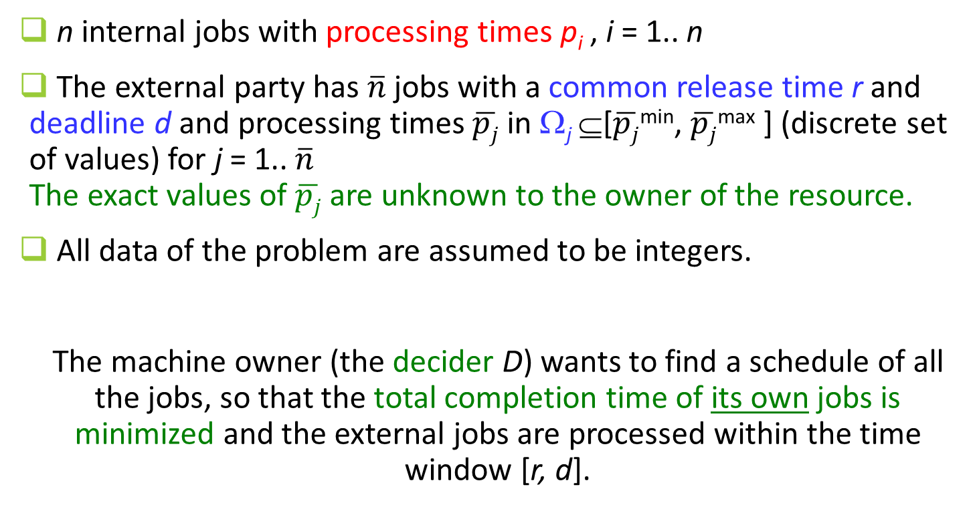
Problem definition
n internal jobs with processing times p_{i} , i = 1.. n
The external party has $\overline{n}$jobs with a common release time r and deadline d and processing times $\overline{pj}$ in Ω_{j} ⊆[$\overline{pj}$^{min}, $\overline{pj}$^{max} ] (discrete set of values) for j = 1.. $\overline{n}$
The exact values of $\overline{pj}$ are unknown to the owner of the resource.
All data of the problem are assumed to be integers.
The machine owner (the decider D) wants to find a schedule of all the jobs, so that the total completion time of its own jobs is minimized and the external jobs are processed within the time window [r, d].
Notes:
Differently from most of the robust scheduling problems addressed in the literature, the processing times of the
internal jobs are deterministic and the uncertainty is relative to the processing times of the external jobs, while
the objective function depends only on the completion times of the jobs of the owner and not on the external
ones.
This makes our problem substantially different from the problems addressed in the literature.

Slide 6


Example
D jobs p_{i}=< 2, 3, 6, 8> External jobs: $\overline{p1}$={1, 2} $\overline{p2}$={3} , r=9, d=15
tot compl time=2+5+11+23=41
2
3
6
1
3
8
$\overline{p1}$=1
0
9
15
t
tot compl time=
2+5+20+28=55
2
3
2
3
6
8
0
9
15
t
2
8
2
3
3
6
total completion time=
2+10+18+24= 54
$\overline{p1}$=2
0
9
15
t
3
6
2
3
2
8
total completion time=
3+9+16+24=52
0
9
15
t

Slide 7
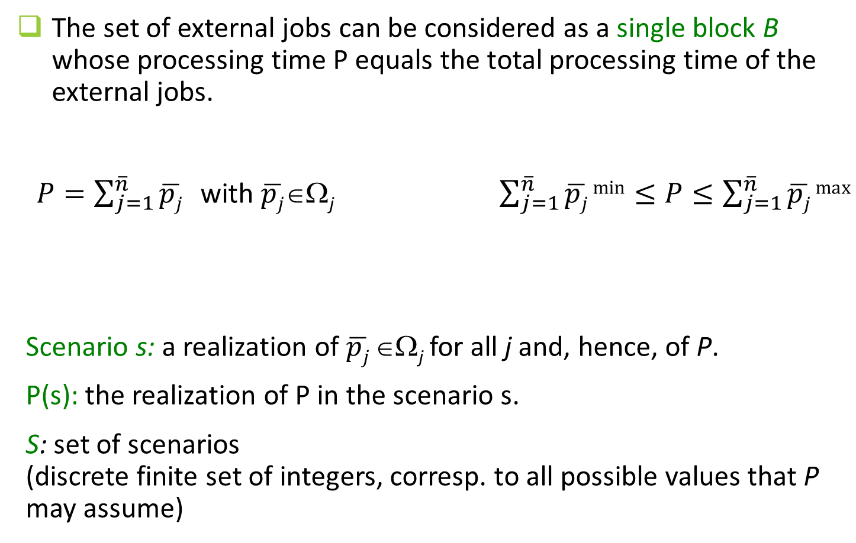
Notation and simplifications
The set of external jobs can be considered as a single block B whose processing time P equals the total processing time of the external jobs.
  $P=\sum_{j=1}^{\overline{n}}{\overline{pj} }$ with $\overline{pj}$∈Ω_{j} $\sum_{j=1}^{\overline{n}}{\overline{pj} min}≤P≤\sum_{j=1}^{\overline{n}}{\overline{pj} max}$
Scenario s: a realization of $\overline{pj}$∈Ω_{j} for all j and, hence, of P.
P(s): the realization of P in the scenario s.
S: set of scenarios
(discrete finite set of integers, corresp. to all possible values that P may assume)
Notes:
With no loss of generality, we may consider the set of external jobs as a single block B whose processing time P equals the total processing time of the external jobs. (By simple exchange arguments, it is in fact possible to prove that for any value of the processing times pj 2 j , there is an optimal solution in which all external jobs
are consecutively processed without interruptions.)
Hence, P = Pn j=1 pj , with pj 2 j , and Pn j=1 pmin j P Pn j=1 pmax j .
In what follows, we define a scenario s as a realization of pj 2 j , for j = 1; : : : ; n, and, hence, of P.
We denote P(s) the realization of P in the scenario s.
Note that, the set S of considered scenarios is a discrete nite set of integers, corresponding to all possible values that P may assume.
As an example, when P may assume all possible integer values in the interval [nj=1 pminj ;Pnj=1 pmaxj ], we have S = fP 2 Z :Pn j=1 pmin j P Pn j=1 pmax j g.

Slide 8
Scheduling maintainance activities
Consider one specific scenario.
The external job B can be seen as a maintenance activity that has to be scheduled in a pre-specified time window.
Several versions of maintenance activity scheduling in the literature.
Scheduling a flexible maintenance activity within a given time interval and minimize jobs total completion time:
  Adiri et al.(1989): NP-hardness
  Yang et al. (2011): dynamic program running in pseudopolynomial time and approximation properties of SPT heuristic
  Xu et al. (2015): propose solution algorithms for the case in which the maintenance period depends on the machine workload.
Notes:
In the addressed problem, the optimal solution for a specific scenario, which is defined for a given realization of the external jobs durations, can be computed by solving the deterministic problem of scheduling multiple jobs and one maintenance activity on a single machine with the objective of minimizing total completion time.
In fact, as we will formally explain later, the set of external jobs can be considered as a single block B whose processing time equals the total processing time of the external jobs.
Clearly, the maintenance activity corresponds to the block B that has to be scheduled within its deadline.
Yang et al. (2011) exactly deal with this problem, namely with the problem of scheduling a maintenance activity, within a given time interval, minimizing jobs total completion time. They show that the problem| which was proven to be NP-hard in Adiri et al. (1989)|can be optimally solved by a dynamic program running in pseudopolynomial time and also that the SPT heuristic is a 9/7-approximation algorithm.
Observe that the complexity of the above deterministic problem trivially implies the NP-hardness of our robust scheduling problem even with one single
scenario.
Several dierent versions of scheduling problems considering maintenance activities, which are usually modelled as machine unavailability, have been addressed in the literature.
For a survey see Ma et al. (2010). Recently, the problem addressed by Yang et al. (2011) has been generalized by Xu et al. (2015) who consider the maintenance period
depending on the machine workload and propose dierent solution algorithms. Moreover, Chen et al. (2013) study a similar version of this problem in which it is not possible to start or complete a job during the maintenance period (while it is allowed to continue its processing).

Slide 9
Solution structure for our problem
A solution of our problem is a sequence π of D jobs, only.
Its value depends on π and on the realization of P and it is equal to the total completion time of the D jobs in the realization schedule σ(π; s).
σ(π; s) is built as follows:
    Given a scenario s and P(s), the block B of the external jobs is processed at the latest available time so that:
      it does not violate the given deadline d and
      it does not introduce any unnecessary idle time in the schedule after its release time.
    The jobs of D are processed according to the sequence π.

Slide 10
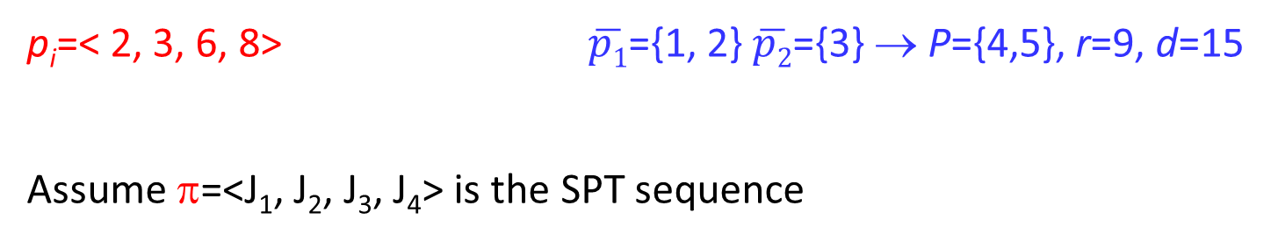
Example
p_{i}=< 2, 3, 6, 8> $\overline{p1}$={1, 2} $\overline{p2}$={3} → P={4,5}, r=9, d=15
Assume π=<J₁, J₂, J₃, J₄> is the SPT sequence
P=4
2
3
6
4
8
0
9
15
t
P=5
2
3
5
6
8
0
9
15
t

Slide 11
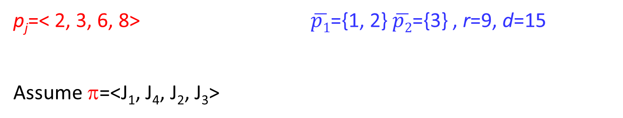
Example
p_{j}=< 2, 3, 6, 8> $\overline{p1}$={1, 2} $\overline{p2}$={3} , r=9, d=15
Assume π=<J₁, J₄, J₂, J₃>
2
8
4
3
6
P=4
0
9
15
t
P=5
2
8
5
3
6
0
9
15
t

Slide 12
Minimax Regret
Regret of a solution x: the difference between the value obtained by x and that of an optimal solution.
several scenarios and different optimal solutions
worst-case (absolute) regret: the maximum value of the regret over all possible scenarios.
minimax regret solution: solution minimizing the worst-case regret.
worst-case relative deviation: the regret of a solution x is measured by the ratio between the value obtained by x and that of an optimal solution.
Notes:
Regret of a solution x =
the difference between the value obtained by x and that of an optimal solution.
If some parameters have uncertain values and may take several different values (and therefore there are different optimal solutions depending on the parameters' values) it makes sense to consider the worst-case regret as the maximum value of the regret over all possible scenarios. In this context, the problem is that of nding the minimax regret solution, i.e., the one minimizing the worst-case regret. The scenario under which the maximum regret is realized is denoted as worst- case absolute deviation scenario. In the literature many authors (e.g., Daniels et al. (1995)), besides the minimax regret, consider also the worst-case relative deviation, where the regret of a solution x is measured by the ratio between the value obtained by x and that of an optimal solution. The scenario under which the maximum ratio is realized is denoted as the worst-case relative deviation scenario.
In this paper, we address the worst-case absolute deviation problem which can be formulated as follows.

Slide 13
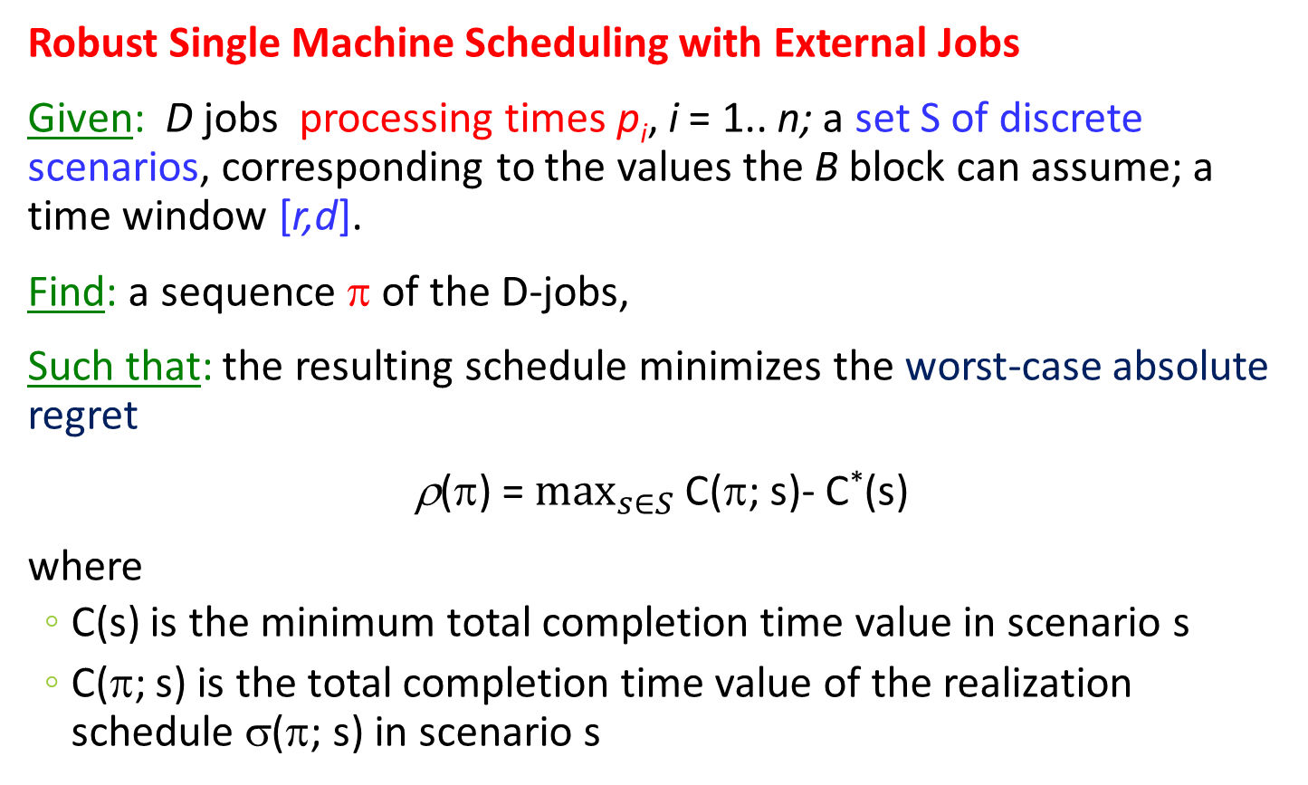
RSEP
Robust Single Machine Scheduling with External Jobs
Given: D jobs processing times p_{i}, i = 1.. n; a set S of discrete scenarios, corresponding to the values the B block can assume; a time window [r,d].
Find: a sequence π of the D-jobs,
Such that: the resulting schedule minimizes the worst-case absolute regret
ρ(π) = $\max_{s∈S}$ C(π; s)- C*(s)
where
  C(s) is the minimum total completion time value in scenario s
  C(π; s) is the total completion time value of the realization schedule σ(π; s) in scenario s

Slide 14
Robust single machine scheduling
Minimization of total completion time on a single machine, when processing times may vary in given intervals:
    Daniels et al. (1995): Two alternative measures of schedule robustness (worst-case absolute or relative deviation from the optimum over all scenarios). Provide several schedule properties.
    Montemanni (2007): MIP formulation and exact solution methods.
    Lebedev et al. (2006): NP-hardness for maximum regret minimization.
    Kasperski et al. (2006): approximation algorithms achieving a constant approximation ratio.
Total weighted completion time:
    Pereira (2016): exact algorithm.
Unrelated machines:
    Conde (2014): polynomial time algorithm for determining the regret given a schedule and uses this result for deriving a MIP formulation for the problem of minimizing maximum regret.
Notes:
Dierently from most of the robust scheduling problems addressed in the literature, the processing times of the
internal jobs are deterministic and the uncertainty is relative to the processing times of the external jobs, while
the objective function depends only on the completion times of the jobs of the owner and not on the external
ones. This makes our problem substantially different from the problems addressed in the literature.
In the context of single machine scheduling problems, robustness is an important issue addressed in several papers.
One of the first papers on this topic is Daniels et al. (1995), where the authors consider two alternative mea-sures of schedule robustness. These measures focus on a given schedule worst-case absolute or relative deviation from the optimum over all scenarios. The authors study the problem of minimizing the total completion time on a single machine, when processing times may vary in given intervals, and established several properties of ro-bust schedules.
Montemanni (2007) proposes for the same problem a MIP formulation and analyzes exact solution methods.
The problem of nding the schedule minimizing the maximum regret on a single machine with processing times varying in given interval has been shown to be NP-hard by Lebedev et al. (2006).
In Kasperski et al. (2006) the same problem is addressed and the authors propose approximation algorithms achieving a constant approximation ratio.
More recently, Pereira (2016) extends the above problem to consider total weighted completion time as a metric and proposes an exact algorithm. Conde (2014) considers the problem of nding the schedule minimizing the maximum regret on unrelated machines. He proposes a polynomial time algorithm for determining the regret given a schedule and uses this result for deriving a MIP formulation for the general problem.

Slide 15
Some properties
RSEP is NP-hard
If the release date of the external block B is r = 0, then RSEP is polynomially solvable and the optimal sequence is obtained by sequencing the D-jobs in SPT order.
Notes:
As shown in Adiri et al. (1989), the problem of scheduling
a exible maintenance activity within given release and
due dates with the objective of minimizing jobs total
completion time is NP-hard. As a consequence, RSEP is
NP-hard, too. Yet, there are a number of polynomially
solvable cases.
In particular, it is quite easy to show that the problem
of scheduling a exible maintenance activity within a
given due date with the objective of minimizing jobs total
completion time can be solved to optimality by sequencing
the jobs in SPT order (this is also mentioned by Yang
et al. (2011)). An immediate consequence of this fact is
the following result.

Slide 16
Some properties
RSEP is NP-hard
If the release date of the external block B is r = 0, then RSEP is polynomially solvable and the optimal sequence is obtained by sequencing the D-jobs in SPT order.
When r > 0, SPT is a 9/7-approximation algorithm for the problem of scheduling a maintenance activity and minimizing total completion time (Yang et al. 2011).
In the context of robust optimization, the performance of an (approximation) algorithm has to be compared to that of the optimal robust solution.
Theorem: The approximation ratio of SPT for RSEP is unbounded.
Notes:
When r > 0, as shown by Yang et al. (2011), SPT is a 9=7-approximation algorithm for the above mentioned (deterministic) problem of scheduling a maintenance activity and minimizing total completion time. In the context of robust optimization, the performance of an (approximation) algo-
rithm A has to be compared to that of the robust solution.
In this case, if I is the set of all instances of the problem, the approximation ratio (A) of algorithm A is given by
(A) = sup
I2I
(A(I))
(I)
(1)
in which (A(I)) is the maximum regret value of the sequence determined by algorithm A on instance I and (I) is the the maximum regret value of a robust solution
on instance I 2 I, i.e. the one minimizing the maximum regret.
The 9=7 approximation bound of SPT still holds when considering as robustness measure the worst-case relative deviation. In fact, for each scenario, the total
completion time value obtained by SPT is at most 9=7 the optimal value for that scenario (which is a lower bound of the robust solution value).
Surprisingly enough, SPT performance is not as good when dealing with our minimax regret scheduling problem RSEP.

Slide 17
Some properties
A natural idea for a solution algorithm:
use as a robust solution a sequence which is optimal in at least one scenario.
This approach does not yield a solution minimizing the maximum regret:
Theorem: The optimal (robust) solution of RSEP may not correspond to the optimal solution of any of the scenarios in S.
Notes:
When a number of scenarios are available, it comes natural to use as a robust solution a sequence which is optimal in at
least one scenario. This could be pursued by iteratively applying the pseudopolynomial dynamic program proposed
by Yang et al. (2011).
Unfortunately, this approach, in general, does not yield aa solution minimizing the maximum
regret as shown below.

Slide 18
Some properties
Consider scheduling problems where all processing times may assume values in given intervals,
a common property:
  when minimizing total completion time, the scenario that maximizes the absolute deviation from the optimum belongs to the set of extreme point scenarios, i.e., in which all processing times values are equal either to their minimum feasible value or to their maximum value (Daniels et al., 1995)
Theorem: There exist an instance I of RSEP and sequence π of the D jobs such that the maximum regret does not correspond to an extreme value of the external job processing time P.

Slide 19
First MILP formulation
Variables
x_{ih} binary variables, defined for all D jobs i=1, …, n indicating whether job i is the h-th D-job in the sequence π
y_{h}(s) binary variables, defined for all h=1, …, n and scenarios s, indicating whether the block B is scheduled between the (h-1)-th and h-th D-jobs in σ(π; s)
(y₁(s) and y_{n}(s) equal to 1 if block B is scheduled before or after all D-jobs)
C_{h}(s) defined for all h and all s, are (an upper bound on ) the completion time of the job in position h.
C_{B}(s) defined for all s, indicates the completion time of block B in σ(π; s)
Notes:
Mixed Integer Linear Programming (MIP) formulations of the problem can be written by explicitly considering all possible scenarios in the nite set S, i.e., all possible realizations P(s) and the values C(s) of the corresponding optimal solutions (i.e., minimum total completion time of D-jobs in the scenario s). Note that in the following MIPs the C(s) are considered as input data.
The rst formulation makes use the following variables.
Let xih be a binary variable, dened for all D jobs i =1; : : : ; n indicating whether job i is the h-th D job in the sequence . Note that, if such a job is preceded by
block B in a scenario s, then it is actually in the (h + 1)-th position of the realization schedule (; s).
Let yh(s) be a binary variable, dened for h = 2; : : : ; n, indicates whether the block B is scheduled between the (h 􀀀 1)-th and h-th D jobs in (; s), and let y1(s) and yn+1(s) be binary variables equal to 1 if the block B is scheduled before and after all the D jobs, respectively. Note that, dierently from x 2 f0; 1gn2 , these variables depend on the realization of P and therefore, in general, they take
Ch(s), dened for all positions h =1; : : : ; n and all scenarios s 2 S, be (an upper bound on)the completion time of the job in position h in . Similarly,
variable CB(s), dened for all scenarios, indicates the completion time of block B, in (; s).

Slide 20
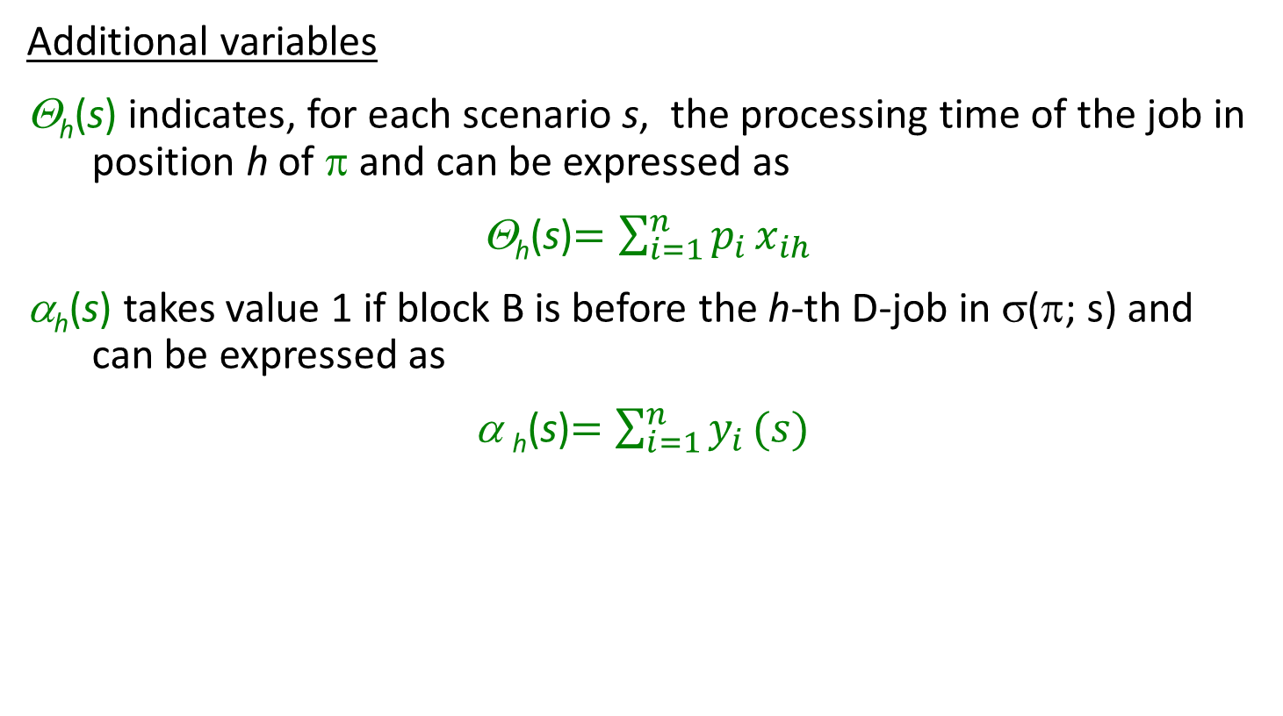
First MILP formulation
Additional variables
Θ_{h}(s) indicates, for each scenario s, the processing time of the job in position h of π and can be expressed as
Θ_{h}(s)$=\sum_{i=1}^{n}{{p_{i }x}_{ih}}$
α_{h}(s) takes value 1 if block B is before the h-th D-job in σ(π; s) and can be expressed as
α _{h}(s)$=\sum_{i=1}^{n}{y_{i }(s)}$

Slide 21
First MILP formulation

Slide 22
First MILP formulation
Opt value of scenario s
Regret of scenario s

Slide 23
First MILP formulation
Jobs to positions assignment constraints

Slide 24
First MILP formulation
Precedence:

Slide 25
First MILP formulation
Block B precedence:

Slide 26
First MILP formulation
Time windows constraints

Slide 27
Second MILP formulation
Variables
x_{ij} binary variables, defined for all pairs of D-jobs i=1, …, n indicating whether job i is sequenced before j in the sequence π
y_{i}(s) binary variables, defined for all i=1, …, n and scenarios s, indicating whether job i is sequenced before block B in σ(π; s)
C_{i}(s) defined for all i and all s, are (an upper bound on ) the completion time of the job i.
C_{B}(s) defined for all scenarios s indicates the completion time of block B in σ(π; s)

Slide 28
Second MILP formulation

Slide 29
Experimental results
We performed a number of tests to assess the quality of the proposed MILPs (and of SPT heuristic).
  36 instance classes each containing 20 instances
  for each instance, 5 scenarios in which the duration of the external job assumes five consecutive integer values.
  tests run on a on a PC equipped with Intel i7 processor and 64 Gb of RAM using CPLEX 12.4. (A time limit of 30 minutes has been set for each instance.)
Notes:
In order to assess the quality of the proposed MIPs, we performed a number of tests on several pseudo-randomly
generated instances.We generated 6 classes of 20 instanceseach, as reported in the rst two columns of Table 1: All
processing times are uniformly distributed in two intervals
[1; 15] and [20; 40]. The time window [r; d] in which the
processing of external job must be executed is roughly
halfway along the schedule and it has a random width
(allowing a slack varying from 0 to 15). For each instance
we considered 5 scenarios in which the duration of the
external job assumes ve consecutive integer values. All
tests were run on a on a PC equipped with Intel i7
processor and 64 Gb of RAM using CPLEX 12.4. A time
limit of 30 minutes has been set for each instance.
a total of 720 instances

Slide 30

Instance classes
Randomly generated using the following parameters:
Number of D-jobs n ∈{50, 100, 200}
Processing times p_{j} and P uniformly distributed in 2 intervals: I₁=[1,15] and I₂=[20,40]
Position of external job time window with respect to overall schedule: in the middle, in the first half, in the second half of the time horizon.
Time windows width is expressed as d - r = P^{max} + slack.
The slack value has been generated with uniform distribution in two intervals: [0,5], [3,10 ]
J₁
...
J_{i}
...
....
J_{h}
0
r
d
$$\sum_{j}{pj}$$
t

Slide 31
Results for processing times in [1,15]
Instance class | # jobs | Processing times | Minimax regret (objective opt. val.) | Time (sec.s) | Total completion time values (average over all scenarios) | Average Regret (per mille)
1 | 50 | [1,15] | 14.55 | 2.01 | 7536.44 | 1.93
2 | 50 | [1,15] | 14.75 | 3.09 | 7024.01 | 2.10
3 | 50 | [1,15] | 0.00 | 0.57 | 7112.78 | 0.00
7 | 50 | [1,15] | 2.25 | 1.91 | 7598.30 | 0.30
8 | 50 | [1,15] | 0.65 | 1.43 | 8089.39 | 0.08
9 | 50 | [1,15] | 0.00 | 0.53 | 7779.51 | 0.00
13 | 100 | [1,15] | 25.10 | 8.71 | 24107.82 | 1.04
14 | 100 | [1,15] | 8.15 | 11.59 | 26970.43 | 0.30
15 | 100 | [1,15] | 0.00 | 1.57 | 31691.21 | 0.00
19 | 100 | [1,15] | 4.00 | 8.35 | 30108.12 | 0.13
20 | 100 | [1,15] | 2.95 | 8.55 | 29924.48 | 0.10
21 | 100 | [1,15] | 0.00 | 1.74 | 24057.91 | 0.00
25 | 200 | [1,15] | 22.30 | 95.85 | 122323.40 | 0.18
26 | 200 | [1,15] | 9.55 | 93.17 | 105631.01 | 0.09
27 | 200 | [1,15] | 0.00 | 5.98 | 107553.32 | 0.00
31 | 200 | [1,15] | 7.75 | 80.96 | 121206.21 | 0.06
32 | 200 | [1,15] | 2.30 | 98.31 | 103597.21 | 0.02
33 | 200 | [1,15] | 0.00 | 6.19 | 116240.67 | 0.00

Slide 32
Computational results (central time wind.)
Class | n | p_{i} | slack | Form.1regret | Form. 1 Time | Form. 2 regret | Form. 2 Time | SPT regret | Tot Compl Time
1 | 50 | [1,15] | [0,5] | 14.55 | 2.01 | 37.0 | 1617.62 | 35.0 | 7536.44
4 | 50 | [20,40] | [0,5] | 47.80 | 1.88 | 302.3 | 1790.43 | 224.6 | 7483.89
7 | 50 | [1,15] | [3,10] | 2.25 | 1.91 | 3.9 | 1326.33 | 8.1 | 7598.30
10 | 50 | [20,40] | [3,10] | 29.10 | 1.59 | 110.5 | 1793.54 | 194.1 | 35443.78
13 | 100 | [1,15] | [0,5] | 25.10 | 8.71 | 38433.7 | 1800.56 | 83.3 | 24107.82
16 | 100 | [20,40] | [0,5] | 12.10 | 11.38 | 151301.3 | 1800.35 | 453.8 | 140815.31
19 | 100 | [1,15] | [3,10] | 4.00 | 8.35 | 28460.8 | 1800.67 | 15.8 | 30108.12
22 | 100 | [20,40] | [3,10] | 44.60 | 9.00 | 152776.9 | 1800.22 | 358.0 | 141336.61
25 | 200 | [1,15] | [0,5] | 22.30 | 95.85 | 160174.9 | 1809.21 | 152.8 | 122323.40
28 | 200 | [20,40] | [0,5] | 105.10 | 100.89 | 600712.5 | 1818.61 | 1031.3 | 539685.79
31 | 200 | [1,15] | [3,10] | 7.75 | 80.96 | 160906.7 | 1802.66 | 47.9 | 121206.21
34 | 200 | [20,40] | [3,10] | 12.75 | 76.93 | 604941.4 | 1804.23 | 465.7 | 525240.79

Slide 33
Computational results (early time window)
Class | n | p_{i} | slack | Form.1 regret | Form. 1 Time | Form. 2 regret | Form. 2 Time | SPT regret | Tot Compl Time
2 | 50 | [1,15] | [0,5] | 14.75 | 3.08 | 23.4 | 1568.5 | 63.85 | 7024.01
5 | 50 | [20,40] | [0,5] | 31.80 | 1.50 | 435.4 | 1786.2 | 348.2 | 8346.10
8 | 50 | [1,15] | [3,10] | 0.65 | 1.42 | 2.0 | 759.9 | 4.8 | 8089.39
11 | 50 | [20,40] | [3,10] | 6.60 | 1.24 | 354.1 | 1773.4 | 1790.5 | 34871.88
14 | 100 | [1,15] | [0,5] | 8.15 | 11.59 | 17651.9 | 1761.0 | 65.5 | 26970.43
17 | 100 | [20,40] | [0,5] | 19.95 | 14.42 | 61676.1 | 1800.4 | 537.8 | 143219.19
20 | 100 | [1,15] | [3,10] | 2.95 | 8.54 | 20688.5 | 1800.7 | 19.6 | 29924.48
23 | 100 | [20.40] | [3,10] | 37.90 | 14.84 | 65450.7 | 1800.6 | 565.9 | 136433.47
26 | 200 | [1,15] | [0,5] | 9.55 | 93.17 | 81159.2 | 1807.3 | 135.2 | 105631.01
29 | 200 | [20,40] | [0,5] | 49.90 | 113.87 | 303418.1 | 1812.9 | 1430.9 | 542584.91
32 | 200 | [1,15] | [3,10] | 2.30 | 98.31 | 81129.5 | 1804.0 | 25.2 | 103597.21
35 | 200 | [20,40] | [3,10] | 23.25 | 99.96 | 303716.9 | 1803.2 | 861.5 | 540200.24

Slide 34
Computational results (late time window)
Class | n | p_{i} | slack | Form.1 regret | Form. 1 Time | Form. 2 regret | Form. 2 Time | SPT regret | Tot Compl Time
3 | 50 | [1,15] | [0,5] | 0 | 0.57 | 0 | 7.10 | 262.5 | 7112.78
6 | 50 | [20,40] | [0,5] | 0 | 0.47 | 0 | 2.65 | 642.5 | 6740.70
9 | 50 | [1,15] | [3,10] | 0 | 0.53 | 0 | 5.75 | 277.5 | 7779.51
12 | 50 | [20,40] | [3,10] | 0 | 0.51 | 0 | 2.47 | 602.5 | 34711.13
15 | 100 | [1,15] | [0,5] | 0 | 1.57 | 0 | 389.47 | 530.0 | 31691.21
18 | 100 | [20.40] | [0,5] | 0 | 1.72 | 0 | 82.54 | 1265.0 | 142973.65
21 | 100 | [1,15] | [3,10] | 0 | 1.74 | 0 | 721.09 | 540.0 | 24057.91
24 | 100 | [20,40] | [3,10] | 0 | 1.71 | 0 | 107.54 | 1315.0 | 137239.94
27 | 200 | [1,15] | [0,5] | 0 | 5.98 | 93183.2 | 1808.36 | 1210.0 | 107553.32
30 | 200 | [20,40] | [0,5] | 0 | 6.02 | 19057.3 | 1305.45 | 2590.0 | 554448.62
33 | 200 | [1,15] | [3.10] | 0 | 6.18 | 92418 | 1803.60 | 1210.0 | 116240.67
36 | 200 | [20,40] | [3,10] | 0 | 5.60 | 32751.2 | 1339.22 | 2510.0 | 531514.29

Slide 35
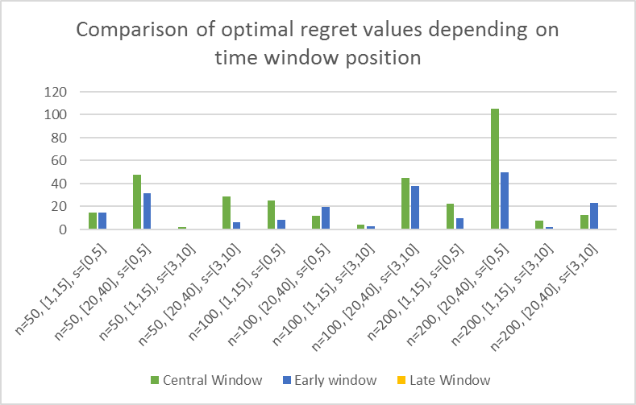
Computational results

Slide 36
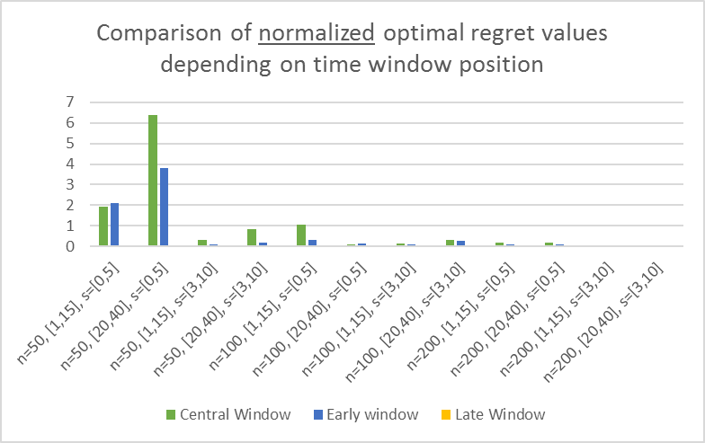
Computational results

Slide 37
Computational results

Slide 38
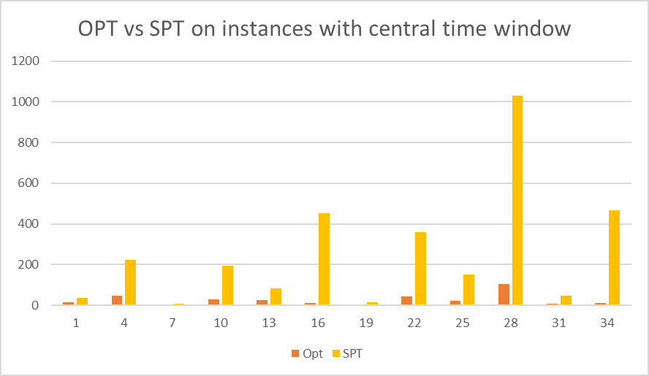
Computational results: SPT performance

Slide 39
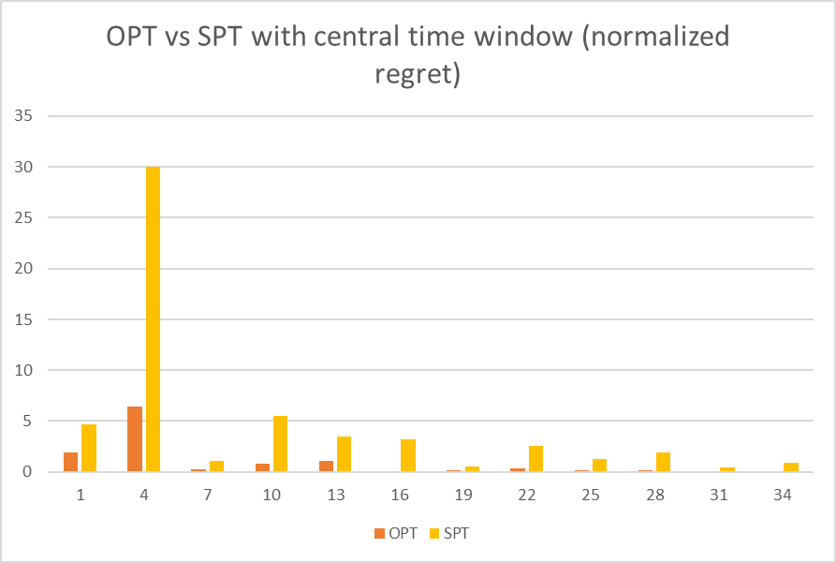
Computational results

Slide 40
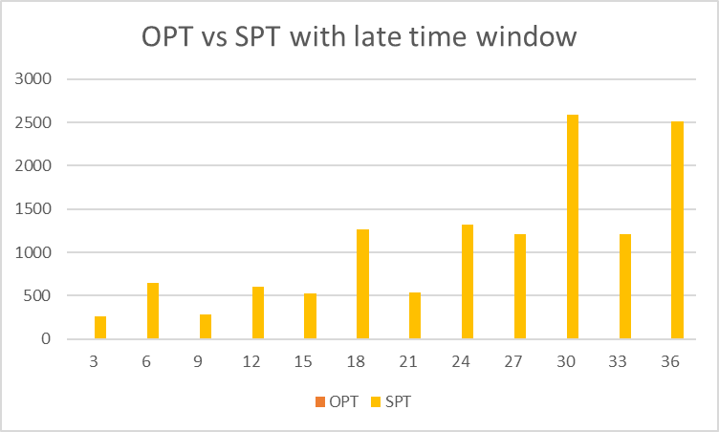
Computational results

Slide 41
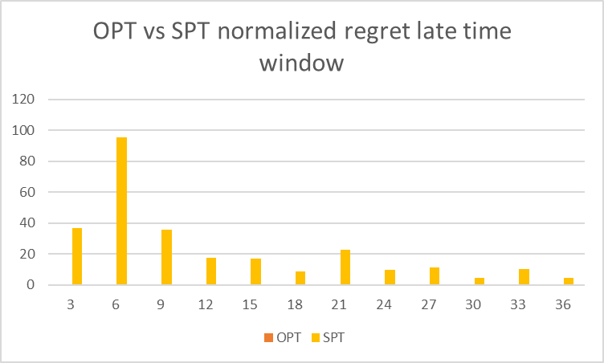
Computational results

Slide 42
Computational results
Instance class | # jobs | Processing times | Minimax regret (objective opt. val.) | Time (sec.s) | Total completion time values (average over all scenarios) | Average Regret (per mille)
1 | 50 | [1,15] | 14.55 | 2.01 | 7536.44 | 1.93
2 | 50 | [1,15] | 14.75 | 3.09 | 7024.01 | 2.10
3 | 50 | [1,15] | 0.00 | 0.57 | 7112.78 | 0.00
4 | 50 | [20,40] | 47.80 | 1.88 | 7483.89 | 6.39
5 | 50 | [20,40] | 31.80 | 1.50 | 8346.10 | 3.81
6 | 50 | [20,40] | 0.00 | 0.48 | 6740.70 | 0.00
7 | 50 | [1,15] | 2.25 | 1.91 | 7598.30 | 0.30
8 | 50 | [1,15] | 0.65 | 1.43 | 8089.39 | 0.08
9 | 50 | [1,15] | 0.00 | 0.53 | 7779.51 | 0.00
10 | 50 | [20,40] | 52.15 | 156.72 | 35443.78 | 1.47
11 | 50 | [20,40] | 6.60 | 1.24 | 34871.88 | 0.19
12 | 50 | [20,40] | 0.00 | 0.52 | 34711.13 | 0.00
13 | 100 | [1,15] | 25.10 | 8.71 | 24107.82 | 1.04
14 | 100 | [1,15] | 8.15 | 11.59 | 26970.43 | 0.30
15 | 100 | [1,15] | 0.00 | 1.57 | 31691.21 | 0.00
16 | 100 | [20,40] | 12.10 | 11.38 | 140815.31 | 0.09
17 | 100 | [20,40] | 19.95 | 14.42 | 143219.19 | 0.14
18 | 100 | [20,40] | 0.00 | 1.73 | 142973.65 | 0.00
19 | 100 | [1,15] | 4.00 | 8.35 | 30108.12 | 0.13
20 | 100 | [1,15] | 2.95 | 8.55 | 29924.48 | 0.10
21 | 100 | [1,15] | 0.00 | 1.74 | 24057.91 | 0.00
22 | 100 | [20,40] | 44.60 | 9.00 | 141336.61 | 0.32
23 | 100 | [20,40] | 37.90 | 14.85 | 136433.47 | 0.28
24 | 100 | [20,40] | 0.00 | 1.71 | 137239.94 | 0.00
25 | 200 | [1,15] | 22.30 | 95.85 | 122323.40 | 0.18
26 | 200 | [1,15] | 9.55 | 93.17 | 105631.01 | 0.09
27 | 200 | [1,15] | 0.00 | 5.98 | 107553.32 | 0.00
28 | 200 | [20,40] | 105.10 | 100.89 | 539685.79 | 0.19
29 | 200 | [20,40] | 49.90 | 113.88 | 542584.91 | 0.09
30 | 200 | [20,40] | 0.00 | 6.02 | 554448.62 | 0.00
31 | 200 | [1,15] | 7.75 | 80.96 | 121206.21 | 0.06
32 | 200 | [1,15] | 2.30 | 98.31 | 103597.21 | 0.02
33 | 200 | [1,15] | 0.00 | 6.19 | 116240.67 | 0.00
34 | 200 | [20,40] | 12.75 | 76.93 | 525240.79 | 0.02
35 | 200 | [20,40] | 23.25 | 99.96 | 540200.24 | 0.04
36 | 200 | [20,40] | 0.00 | 5.61 | 531514.29 | 0.00

Slide 43
Conclusions
a new robust single machine scheduling problem
some (mostly negative) results
two MILP models: performed tests show that one of the models exhibits promising performance
Further research:
additional computational tests
derive some properties characterizing robust schedules
at least in some special cases, a solution algorithm can be designed based on a dynamic program
improve SPT heuristic or design new heuristic algorithms
Notes:
a new robust single machine scheduling problem which has a strong relation to the problem of scheduling a maintenance activity under certain time constraints.
We presented some (mostly negative) results, showing that several properties holding for a number of robust scheduling and maintenance scheduling problems, do not apply to the addressed problem.
Moreover, we proposed two MIP models: Some preliminary computa
tional tests show that at least one of the models exhibits promising performance.
This work puts forward several directions of further research. Firstly, we must carry on with the computationaltests to thoroughly measure the eectiveness and e-ciency of the proposed mathematical programs. Moreover,it would be interesting to derive some properties characterizing robust schedules in this context. Finally, we are condent that, at least in some special cases, a solution
algorithm can be designed based on a dynamic program
similar to that of Yang et al. (2011).

